Slide 1

UI
Notes:
Novelty of the Idea
User Experience
Scale-ability
Completeness of the project (your project is actually working!)
Judge’s Bonus Point (if a judge favours a project for reasons outside above items).

Slide 2
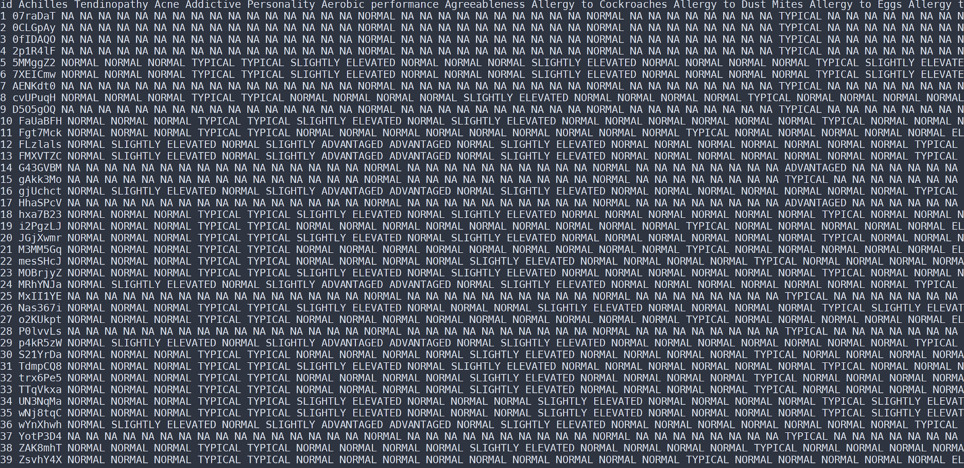

Slide 3
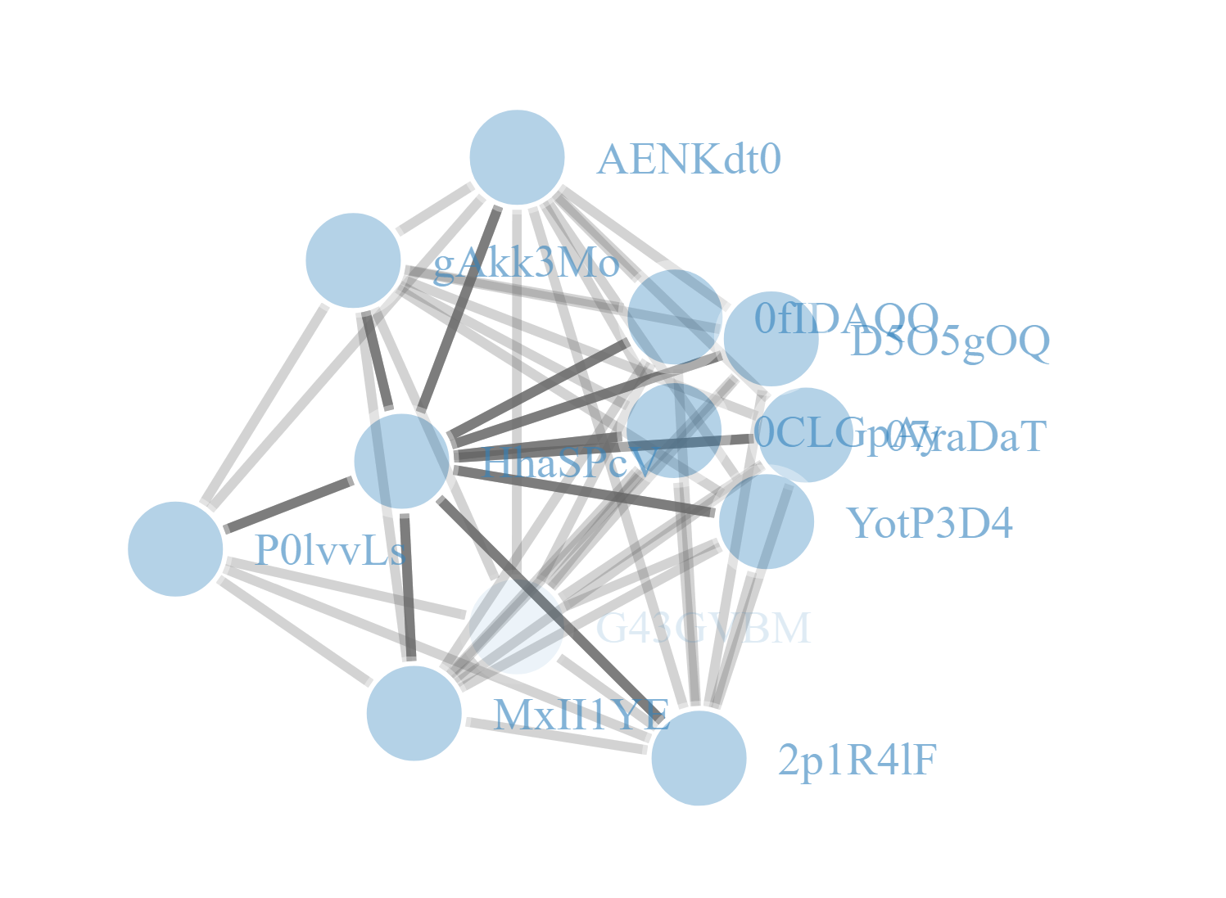

Slide 4
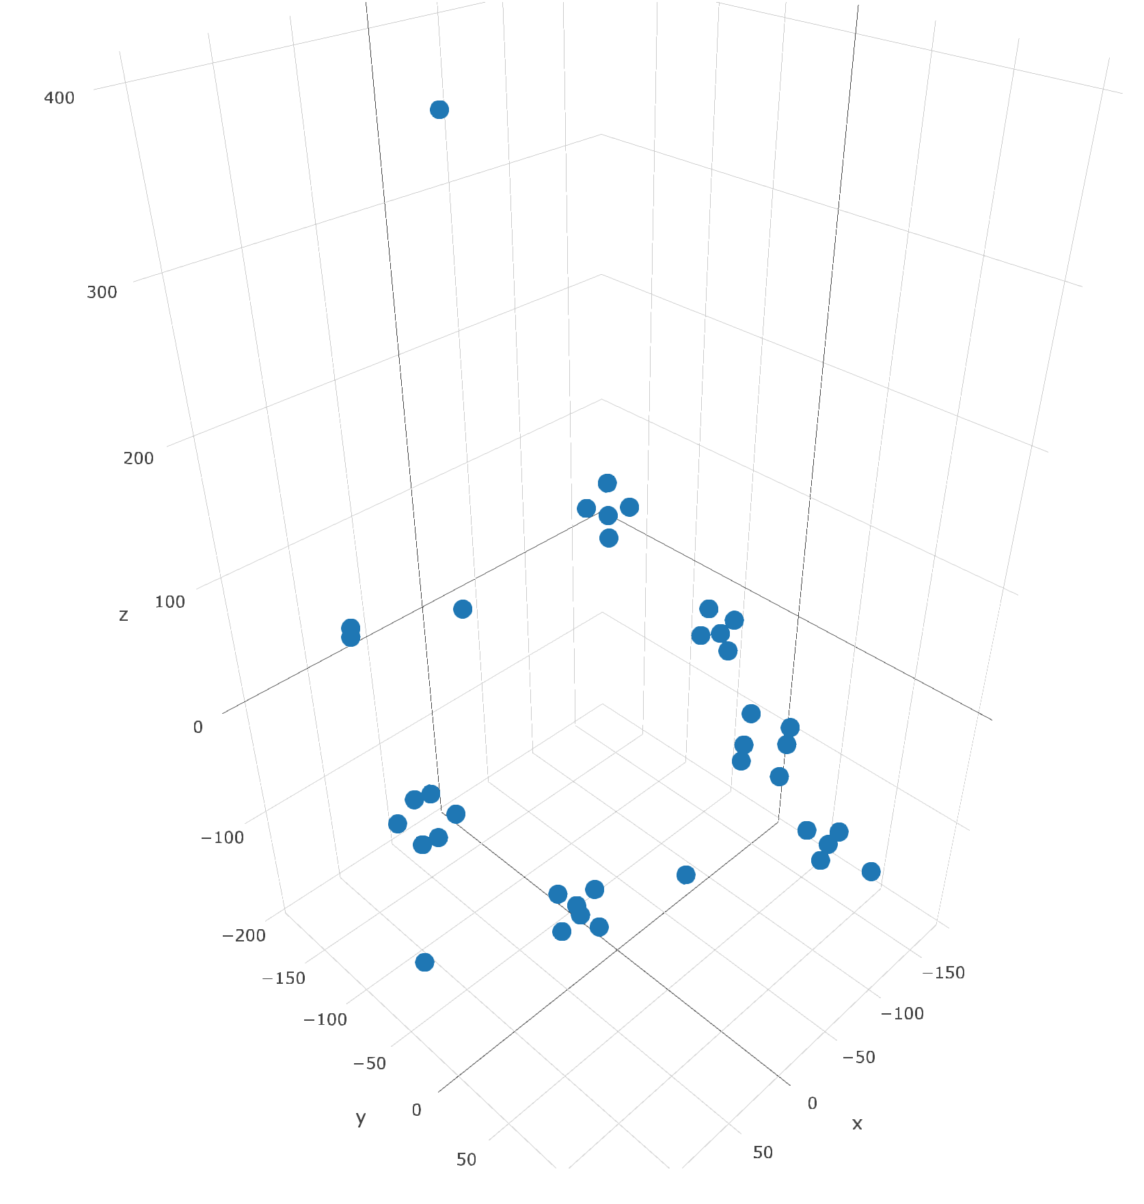
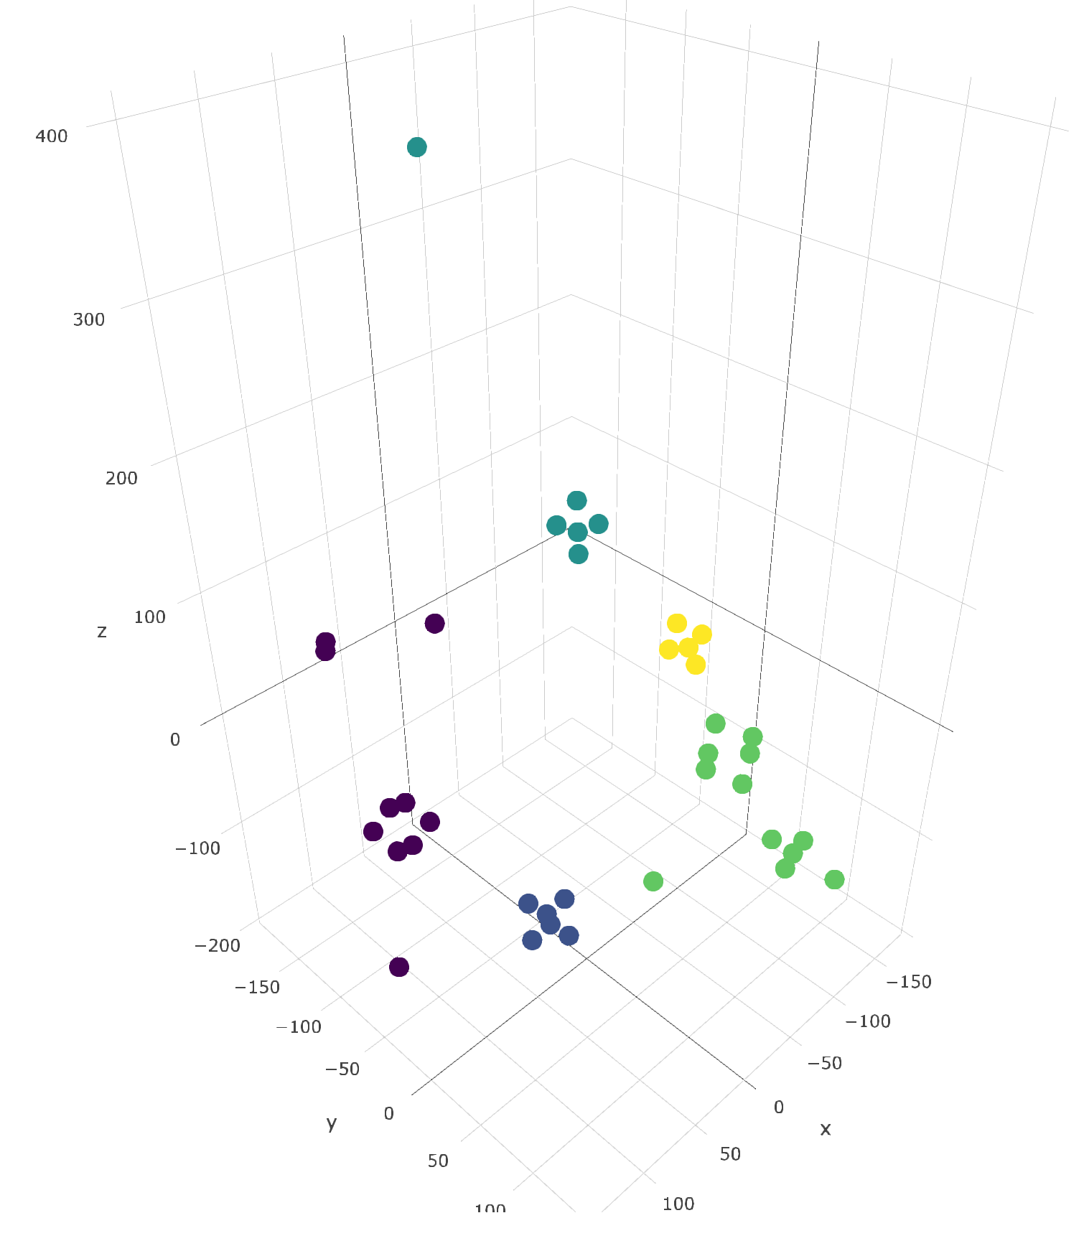
Notes:
Knowing your genetic make-up can be really exciting, but you may put yourself in the situation where you’re not doing anything about it. We think that adding a community component, where users can engage in team-based games, will be an integral part of the journey to self-improvement.

Slide 5
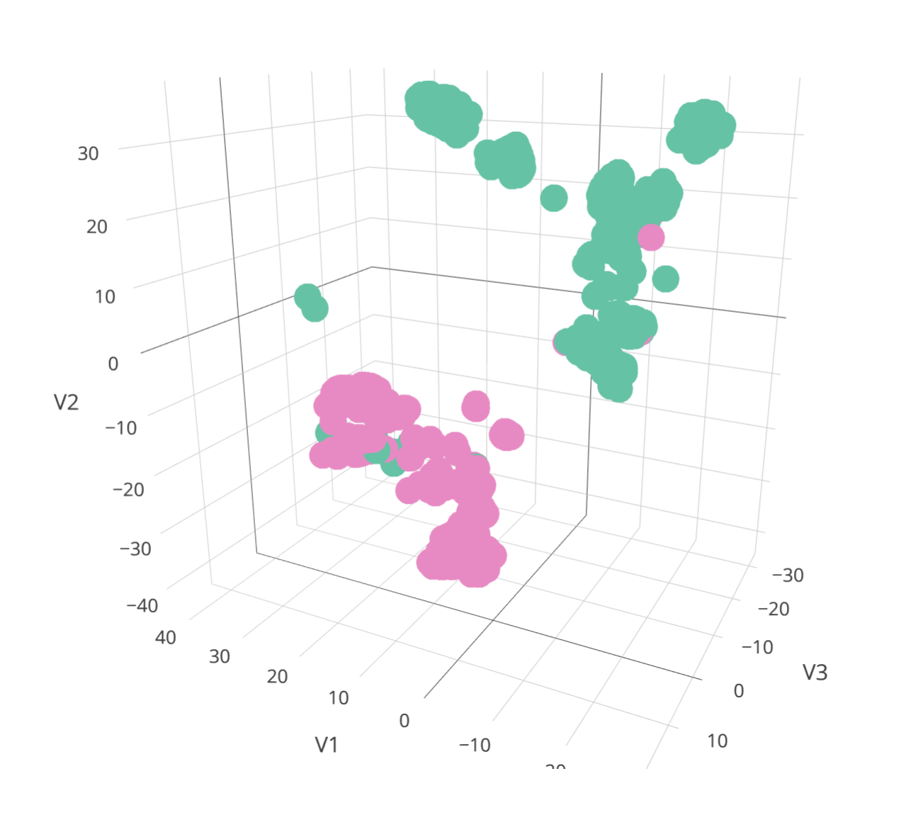

Slide 6
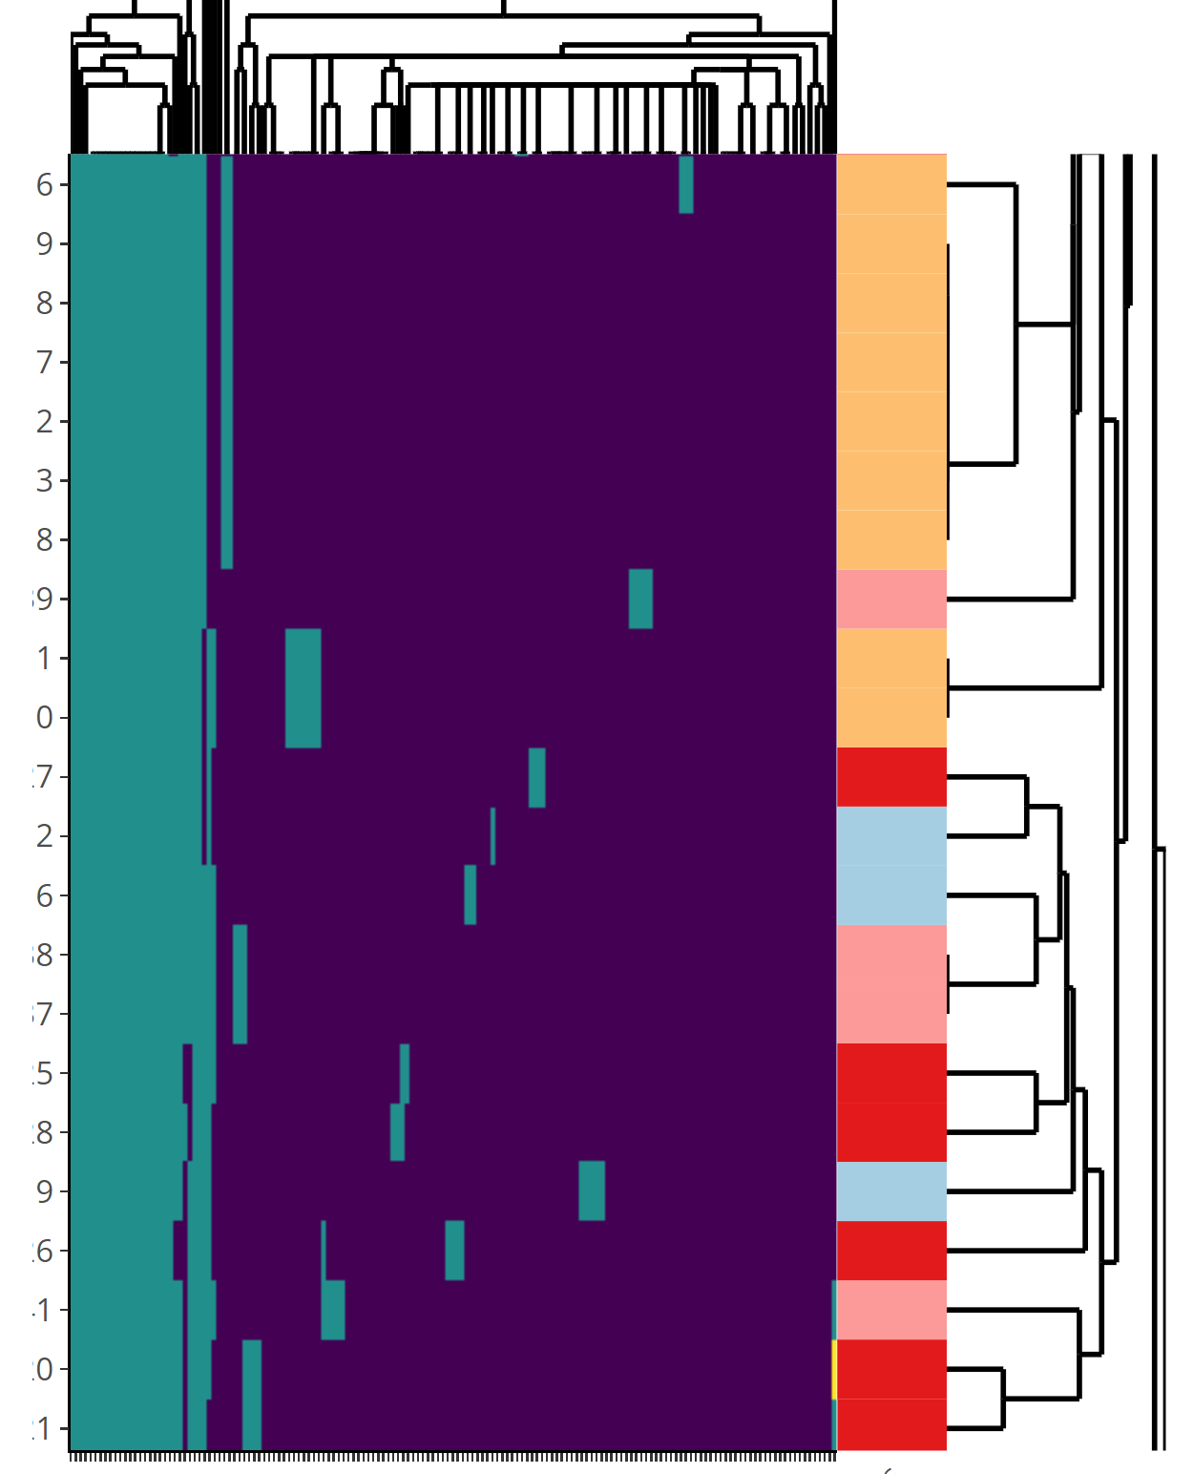

Slide 7
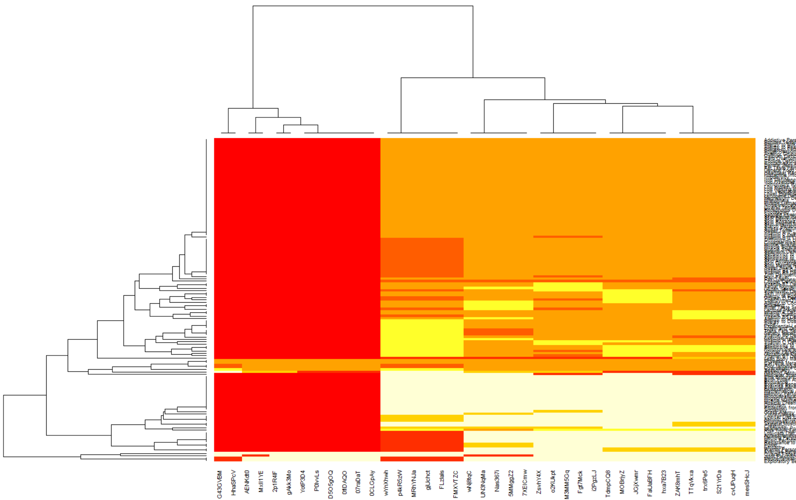

Slide 8
Ask your gene!

